Slide 1


Automated Irrigation System for Efficient and Portable Farming Paper ID: 121
Track Name: PICC 2023
Outline
Authors: Aditya A. Desai; Rajanikant A. Metri; Shreyas R. Patil; Aishwarya A. Nagargoje; Devika S. Desai
Kasegaon Education Society’s
Rajarambapu Institute of Technology, Rajaramnagar
(An Autonomous Institute)
(Approved by AICTE, affiliated to Shivaji University Kolhapur)
Presented by
Aditya A. Desai

Slide 2
Automated Irrigation System for Efficient and Portable Farming Paper ID: 121
Outline
Track Name: PICC 2023
Introduction
Research Objectives
Research METHOD
Modelling
Results
Conclusion
References
Authors: Aditya A. Desai; Rajanikant A. Metri; Shreyas R. Patil; Aishwarya A. Nagargoje; Devika S. Desai
Kasegaon Education Society’s
Rajarambapu Institute of Technology, Rajaramnagar
(An Autonomous Institute)
(Approved by AICTE, affiliated to Shivaji University Kolhapur)
Presented by
Aditya A. Desai

Slide 3

Automated Irrigation System for Efficient and Portable Farming Paper ID: 121
Track Name: PICC 2023
WATER LEVELS
ENERGY USAGE
INTRODUCTION
Outline
Introduction
Research Objectives
Research METHOD
Modelling
Results
Conclusion
References
Ground water level is decreasing
8.8 crore acre-feet in the last decade
20-22% of total energy consumptions consumed by agriculture sector
there is definite need of an efficient solution of irrigation automation.
To make an fully automated irrigation system
20/04/23
PICC 2023 (PID121)
3
NEED
PROBLEM ?
Authors: Aditya A. Desai; Rajanikant A. Metri; Shreyas R. Patil; Aishwarya A. Nagargoje; Devika S. Desai
Kasegaon Education Society’s
Rajarambapu Institute of Technology, Rajaramnagar
(An Autonomous Institute)
(Approved by AICTE, affiliated to Shivaji University Kolhapur)
Presented by
Aditya A. Desai

Slide 4

Outline
INTRODUCTION
OBJECTIVES
Introduction
Research Objectives
Research METHOD
Modelling
Results
Conclusion
References
WATER LEVELS
ENERGY USAGE
Ground water level is decreasing
8.8 crore acre-feet in the last decade
20-22% of total energy consumptions consumed by agriculture sector
there is definite need of an efficient solution of irrigation automation.
To make an fully automated irrigation system
NEED
PROBLEM ?
20/04/23
PICC 2023 (PID121)
4

Slide 5
INTRODUCTION
WATER LEVELS
ENERGY USAGE
OBJECTIVES
Ground water level is decreasing
8.8 crore acre-feet in the last decade
20-22% of total energy consumptions consumed by agriculture sector
To make an fully automated irrigation system
there is definite need of an efficient solution of irrigation automation.
20/04/23
PICC 2023 (PID121)
5
NEED
PROBLEM ?

Slide 6
OBJECTIVES
DEMERITS
RESEARCH METHOD : DEMERITS
RESEARCH METHOD : PRESENT TECHNOLOGIES
There Are Two Major Technologies In The Market
TIMER
BASED
MOISTURE BASED
Soil behaves differently in different climates.
Need of water is different for different time.
We can set time only ones no automatic control over water level in the soil .
Open loop sytem - Therefor NO FEEDBACK
We cant rely only on the data given by moisture sensor.
As soon as water touches sensor motor turns off.
Only applicable for smaller models.
Not used vastly commercially.
Timer decides on and off of motor
motor turned on after completing of 1 Timer
Motor turns off after completing of 2nd Timer.
Turning on and off of motor is decided by moisture sensor.
Motor turns on if moisture sensor detects no water in soil.
Motor gets off when moisture sensor detects water
.
20/04/23
PICC 2023 (PID121)
6

Slide 7
There Are Two Major Technologies In The Market
OBJECTIVES
RESEARCH METHOD : DEMERITS
DEMERITS
TIMER
BASED
MOISTURE BASED
Soil behaves differently in different climates.
Need of water is different for different time.
We can set time only ones no automatic control over water level in the soil .
Open loop sytem - Therefor NO FEEDBACK
We cant rely only on the data given by moisture sensor.
As soon as water touches sensor motor turns off.
Only applicable for smaller models.
Not used vastly commercially.
20/04/23
PICC 2023 (PID121)
7
Timer decides on and off of motor
motor turned on after completing of 1 Timer
Motor turns off after completing of 2nd Timer.
Turning on and off of motor is decided by moisture sensor.
Motor turns on if moisture sensor detects no water in soil.
Motor gets off when moisture sensor detects water
.

Slide 8
DEMERITS
TIMER
BASED
MOISTURE BASED
RESEARCH METHOD : DEMERITS
Soil behaves differently in different climates.
Need of water is different for different time.
We can set time only ones no automatic control over water level in the soil .
Open loop sytem - Therefor NO FEEDBACK
We cant rely only on the data given by moisture sensor.
As soon as water touches sensor motor turns off.
Only applicable for smaller models.
Not used vastly commercially.
20/04/23
PICC 2023 (PID121)
8

Slide 9


PROPOSED SYSTEM
INTEGRATION OF TIMER AND MOISTURE SENSOR
INTEGRATION OF TIMER AND MOISTURE SENSOR
Provide full life cycle irrigation plan for particular plant
Motor will be on and off with timer . moisture sensor will act as a feedback.
Timer will be reset automatically according to climate
Optimum Preset will be given to particular kind of plant

Slide 10
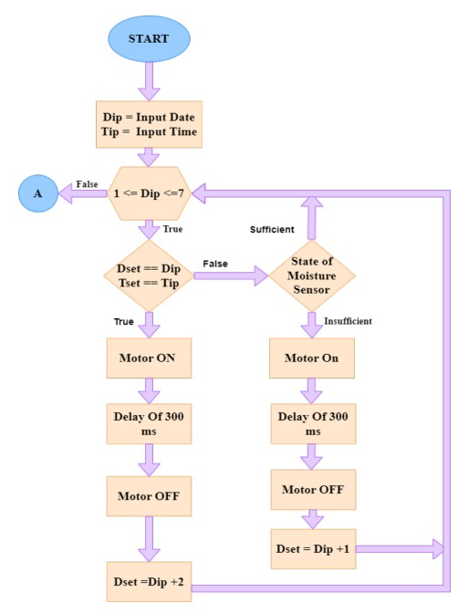
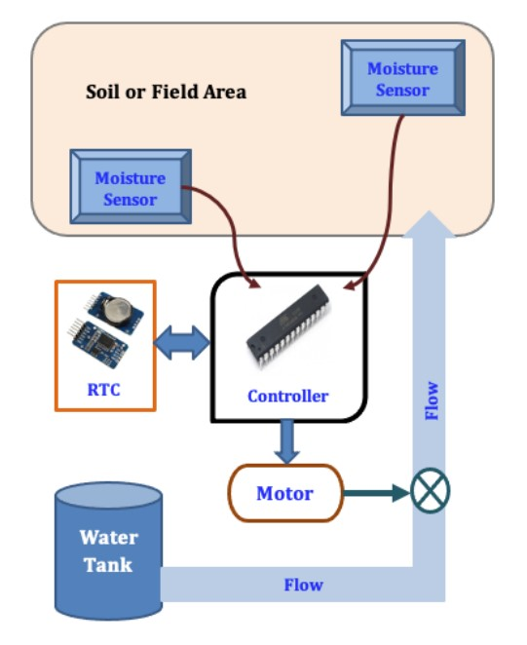
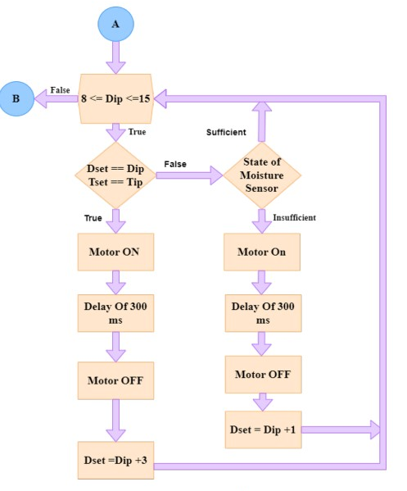
PROPOSED SYSTEM
INTEGRATION OF TIMER AND MOISTURE SENSOR
Provide full life cycle irrigation plan for particular plant
Optimum Preset will be given to particular kind of plant

Slide 11
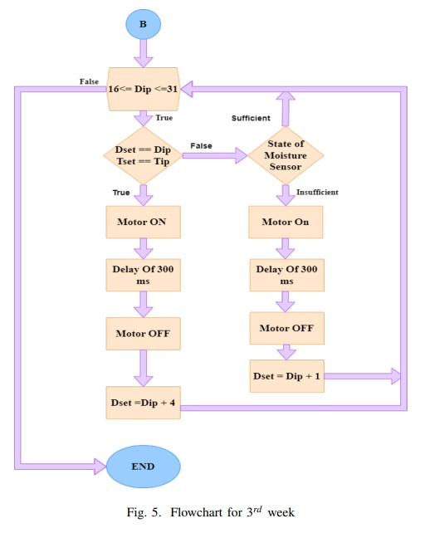
PROPOSED SYSTEM
Provide full life cycle irrigation plan for particular plant
INTEGRATION OF TIMER AND MOISTURE SENSOR
Optimum Preset will be given to particular kind of plant

Slide 12
PROPOSED SYSTEM
HARDWARE IMPLEMENTATION
Provide full life cycle irrigation plan for particular plant
Optimum Preset will be given to particular kind of plant

Slide 13

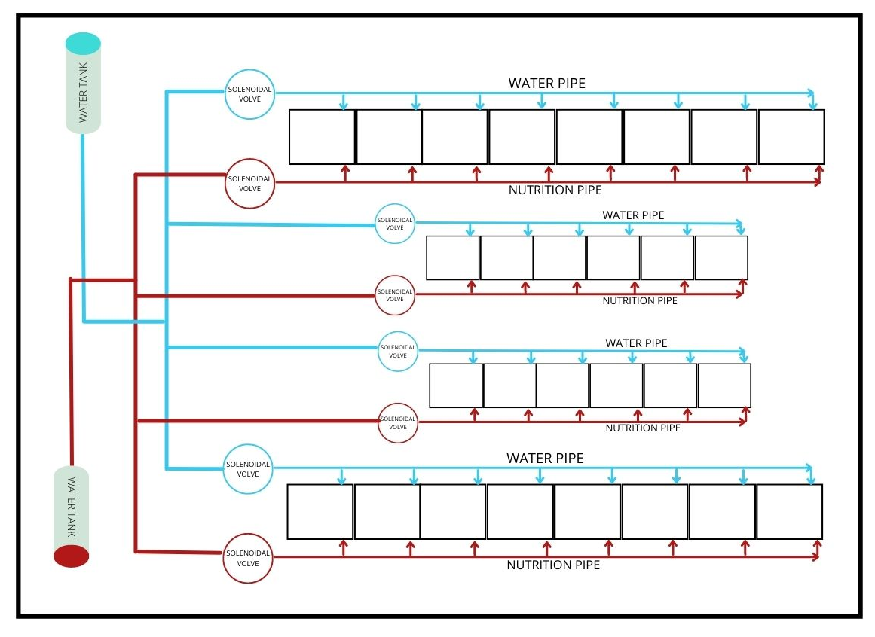
PROPOSED SYSTEM
HARDWARE IMPLEMENTATION
Provide full life cycle irrigation plan for particular plant
PLAN
OF
INSTALLATION
Optimum Preset will be given to particular kind of plant

Slide 14
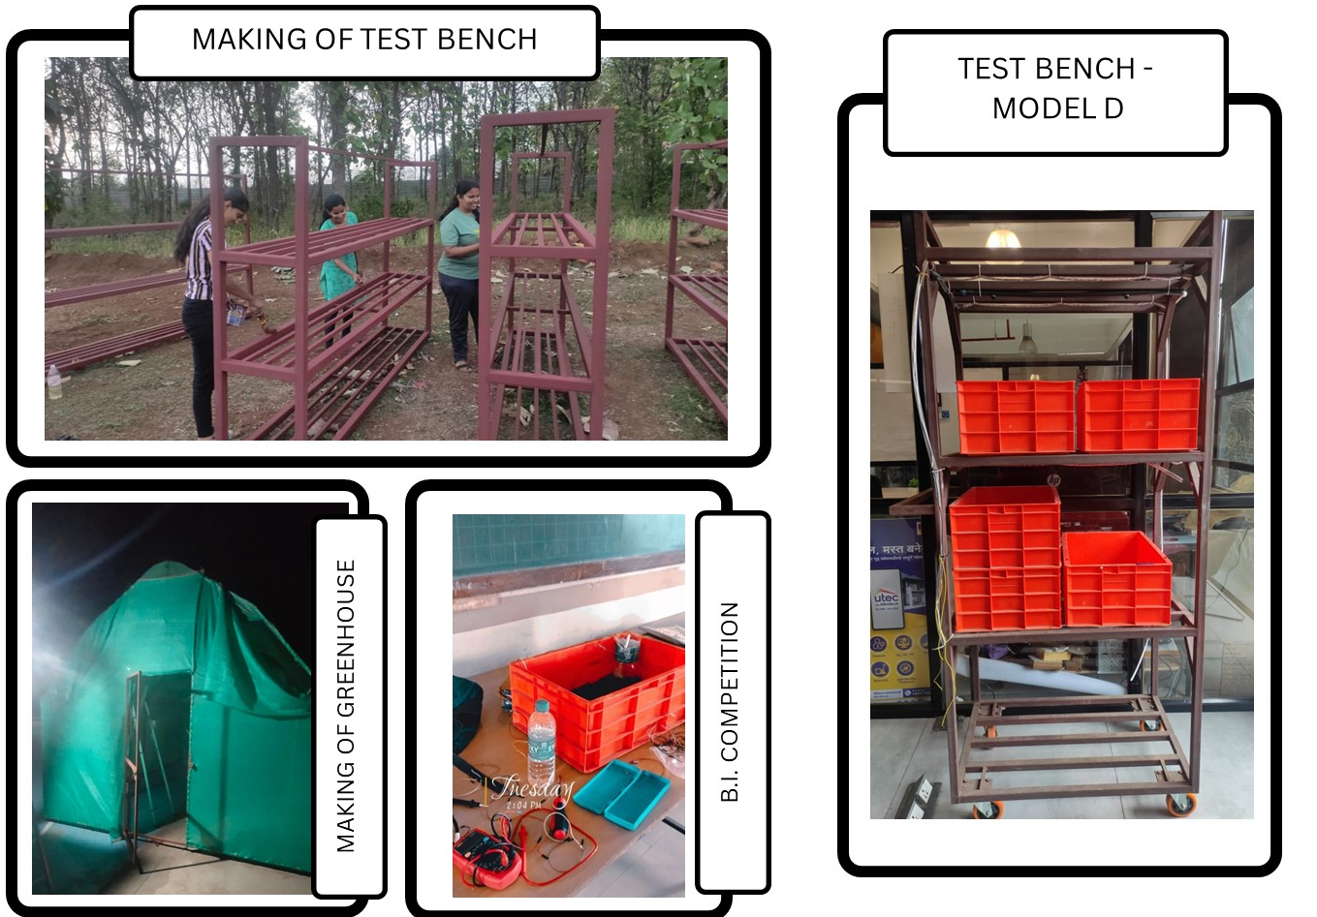
PROPOSED SYSTEM
HARDWARE IMPLEMENTATION
Provide full life cycle irrigation plan for particular plant
PLAN
OF
INSTALLATION
Optimum Preset will be given to particular kind of plant

Slide 15
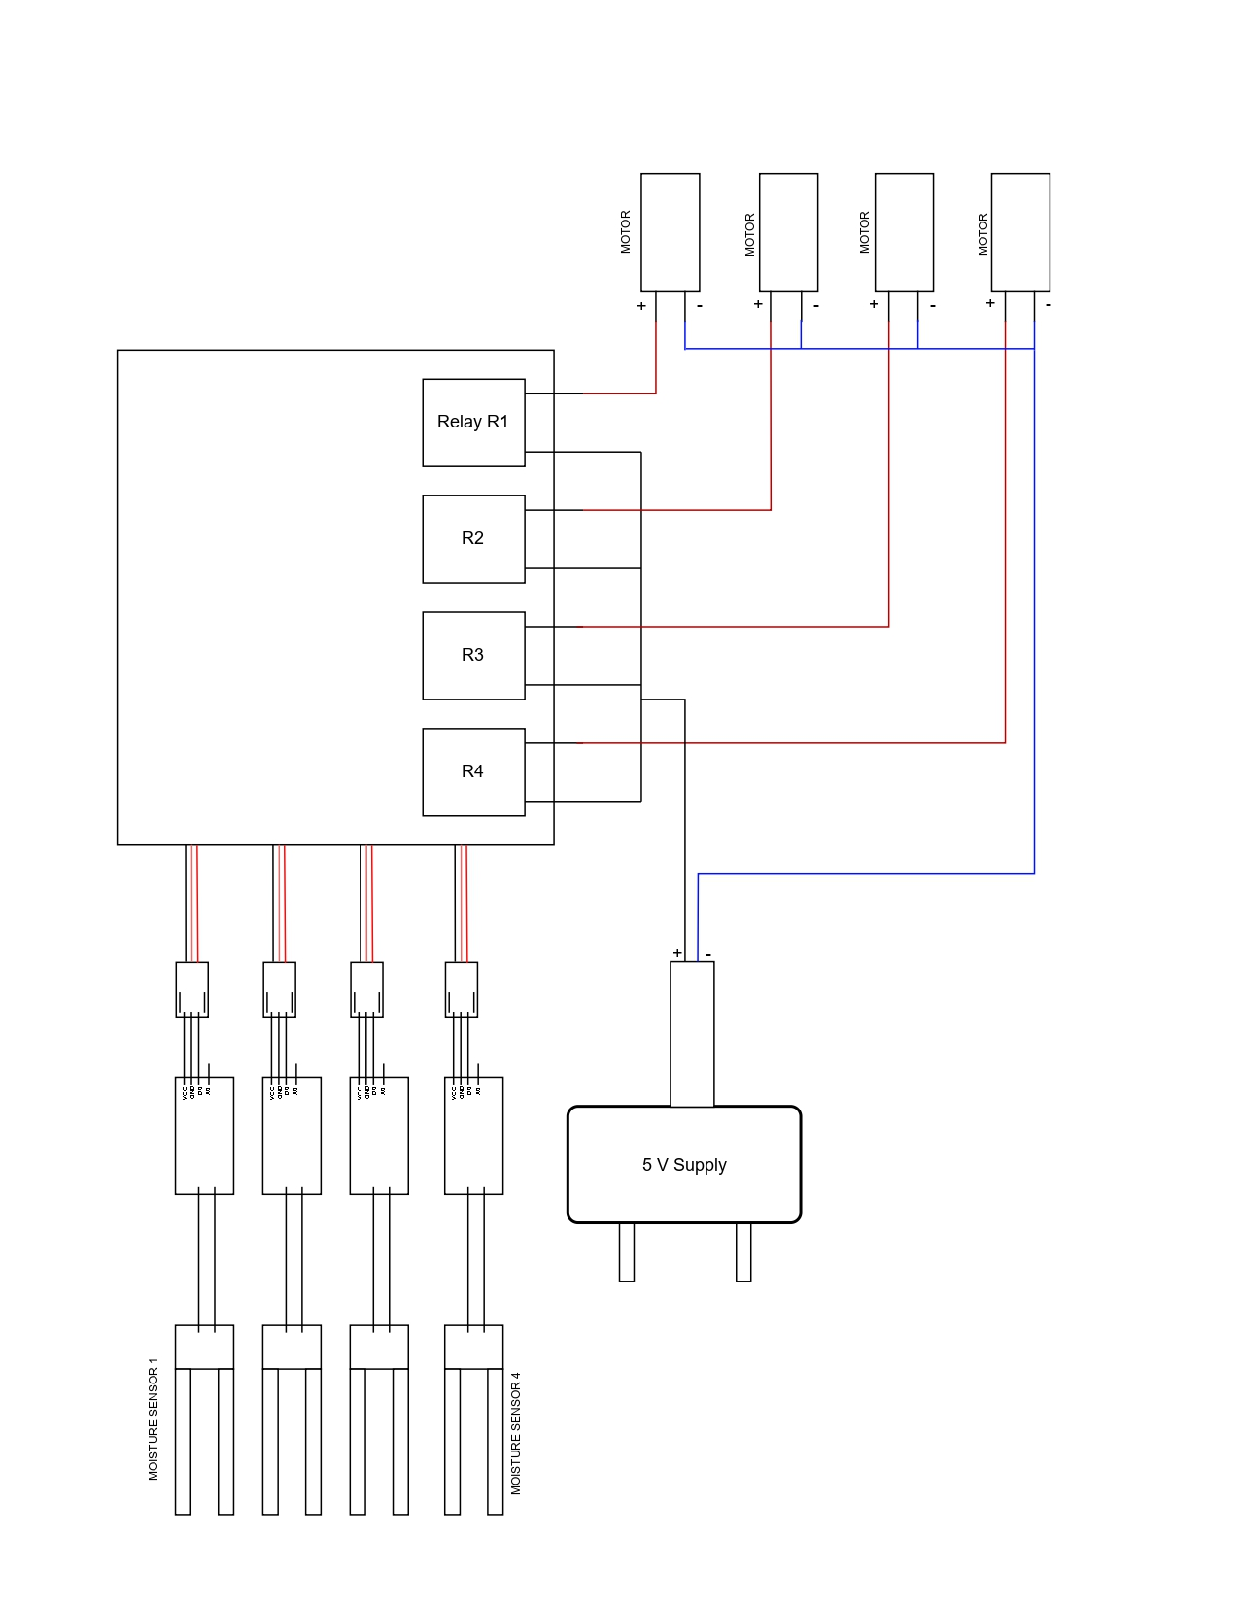
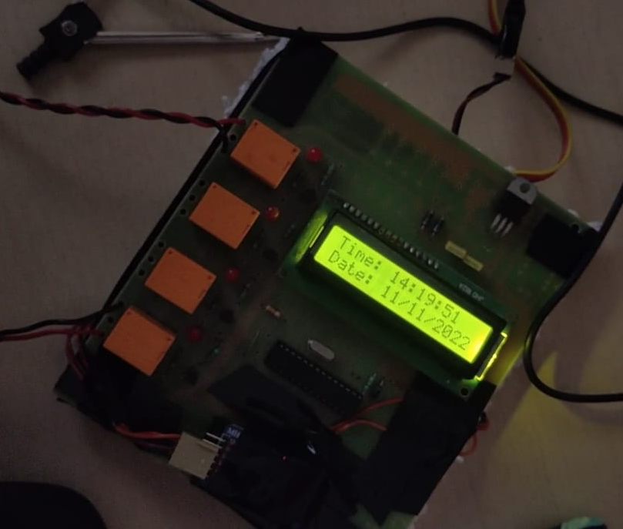
PROPOSED SYSTEM
HARDWARE IMPLEMENTATION
Provide full life cycle irrigation plan for particular plant
ACTUAL
HARDWARE
Optimum Preset will be given to particular kind of plant

Slide 16
PROPOSED SYSTEM
RESULTS
&
HARDWARE IMPLEMENTATION
PCB
DISCUSSIONS

Slide 17
HARDWARE IMPLEMENTATION
RESULTS
&
PCB
DISCUSSIONS

Slide 18

&
DISCUSSIONS
RESULTS
CALCULATED
RESULT
1. ELECTRICITY USAGE

Slide 19

&
DISCUSSIONS
RESULTS
CALCULATED
RESULT
2. WATER USAGE
1. ELECTRICITY USAGE
60
30,000
15
40
20,000
10
20
10,000
5
0
0
0
Electricity Usage (Rs.)
water usage (Ltr)
Human Efforts Time (hr)

Slide 20
&
DISCUSSIONS
RESULTS
CONCL-
60
30,000
15
CALCULATED
40
USION
20,000
10
RESULT
2. WATER USAGE
20
10,000
5
1. ELECTRICITY USAGE
0
0
0
Electricity Usage (Rs.)
water usage (Ltr)
Human Efforts Time (hr)

Slide 21
&
DISCUSSIONS
RESULTS
CONCL-
60
30,000
15
40
20,000
USION
10
20
10,000
5
0
0
0
Electricity Usage (Rs.)
water usage (Ltr)
Human Efforts Time (hr)

Slide 22

THANK Y U

